Slide 1
Lecture 6 Machine Learning

Slide 2
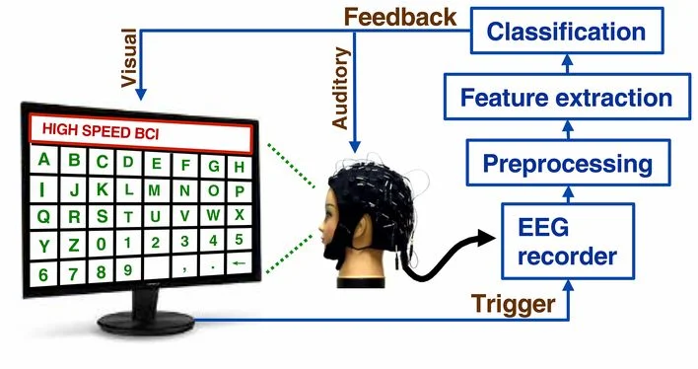
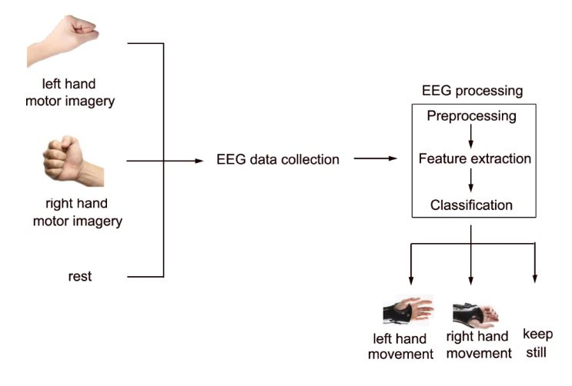
Review

Slide 3
Machine Learning
“Learning is any process by which a system improves performance from experience.”
- Herbert Simon Definition by Tom Mitchell (1998): Machine Learning is the study of algorithms that • improve their performance P • at some task T • with experience E.
A well-defined learning task is given by <P, T, E>.

Slide 4
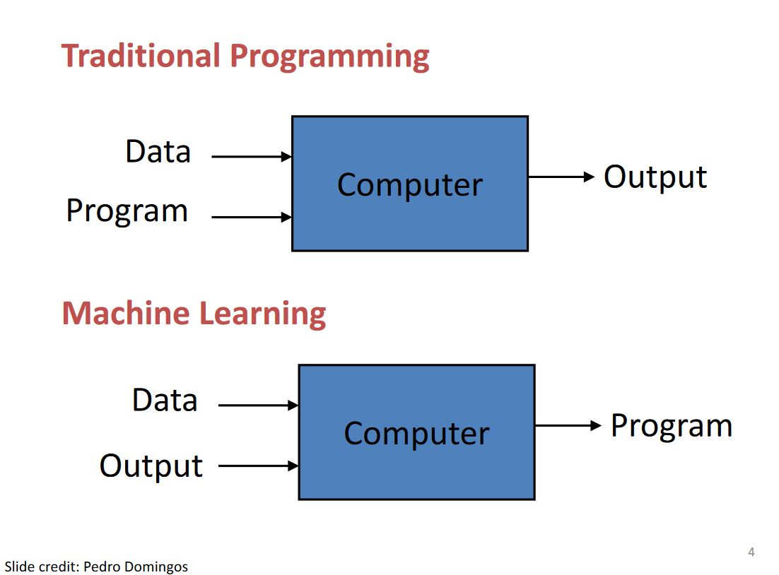

Slide 5

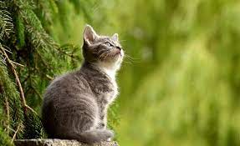
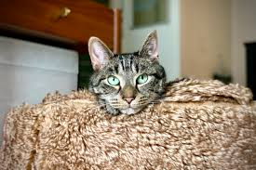
Why is machine learning helpful as compared to explicit algorithms?
Motivation 1 (Image recognition): Humans cannot explain their expertise (E. Alpaydin). Thus, it is extremely challenging to define the features using a set of algorithms or if statements.

Slide 6

Why is machine learning helpful as compared to explicit algorithms?
Motivation 2 (Customized medicine): Models must be customized (E. Alpaydin). It is impossible to write a different set of algorithms for each person.
Human microbiome project

Slide 7
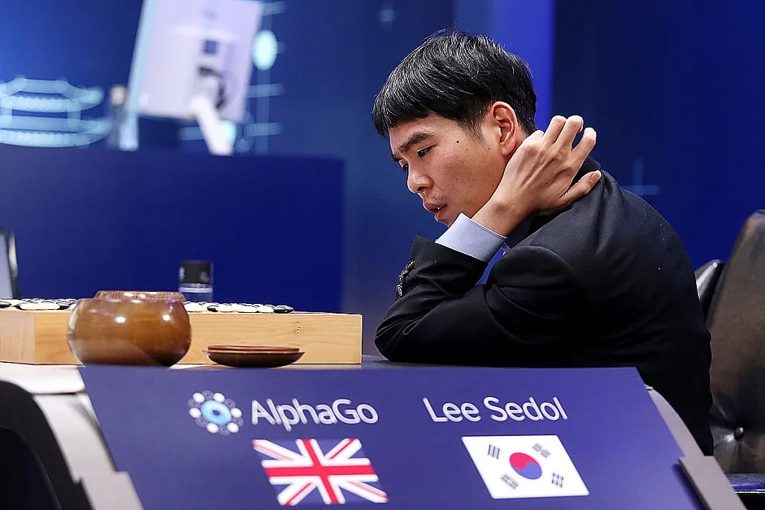

Machine Learning Applications - AlphaGo

Slide 8


Media Recommendation System

Slide 9
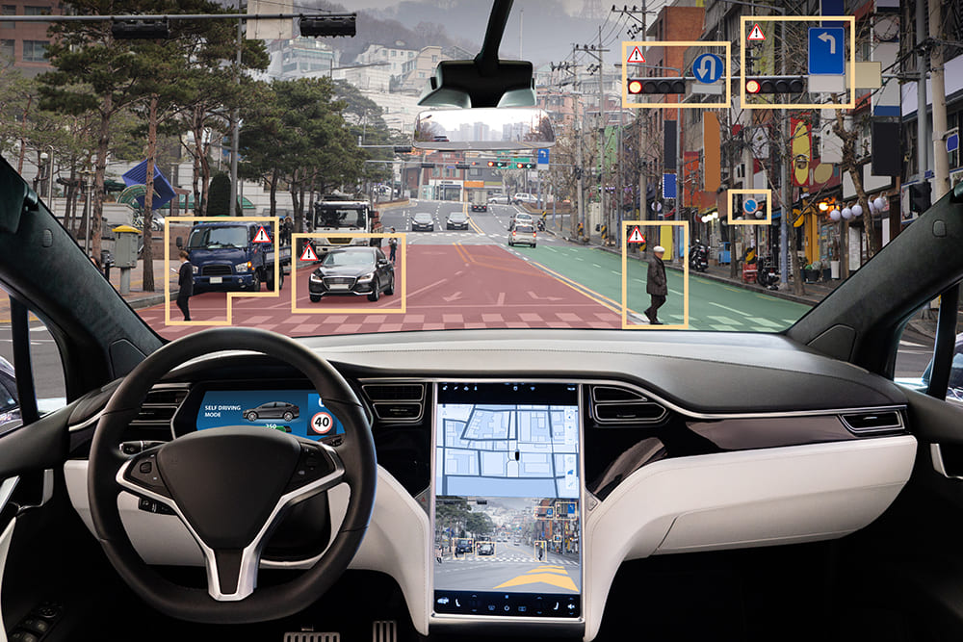
Autonomous Vehicles

Slide 10

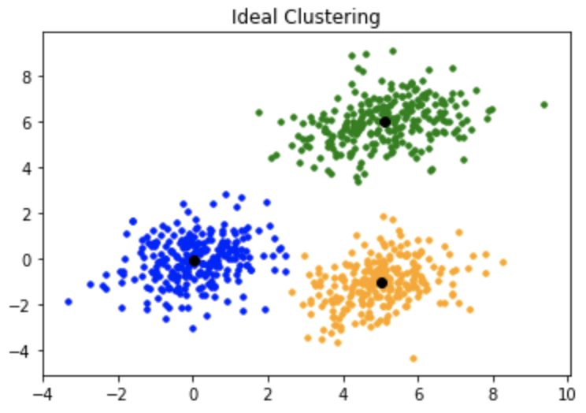
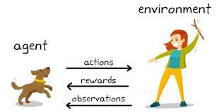
Types of Machine Learning
Supervised Learning
Given: Training data + desired output (labels)
Classification & Regression
Unsupervised Learning
Given: Training data (without labels)
Reinforcement Learning
Rewards from sequence of actions
Based on slide by Pedro Domingos

Slide 11
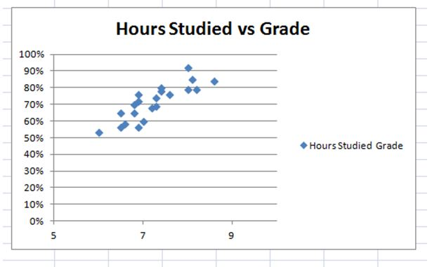
Supervised Learning model for regression
Linear regression: Linear regression analysis is used to predict the value of a variable based on the value of another variable that is known.
Notes:
https://blog.udemy.com/linear-regression-example/

Slide 12
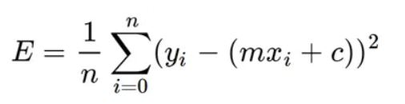
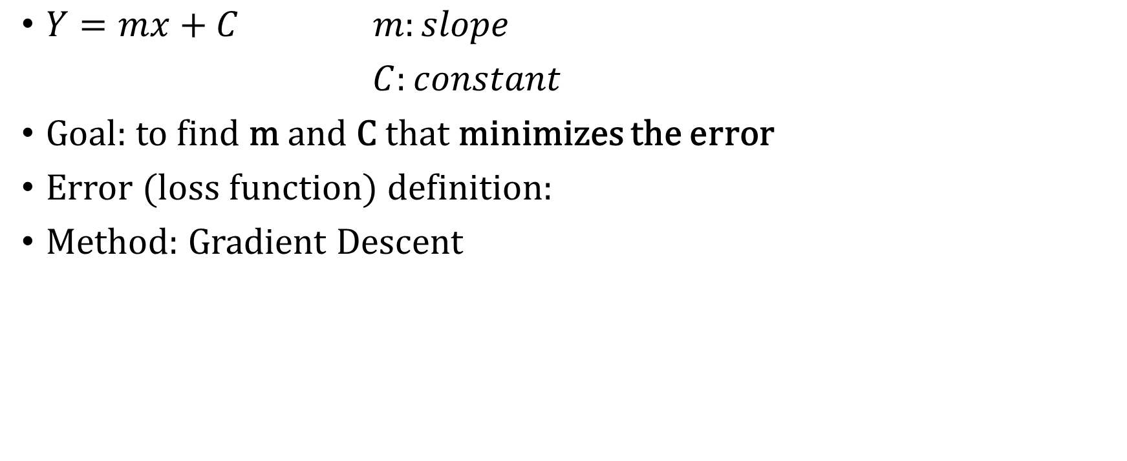
Linear Regression Explained
x | y
0 | 2.1
1 | 4.8
2 | 8
3 | 10.5
4 | 14.3
$Y=mx+C m:slope$
$C:constant$
Goal: to find m and C that minimizes the error
Error (loss function) definition:
Method: Gradient Descent
Slide based on the article “Linear Regression using Gradient Descent“ written by Adarsh Menon

Slide 13
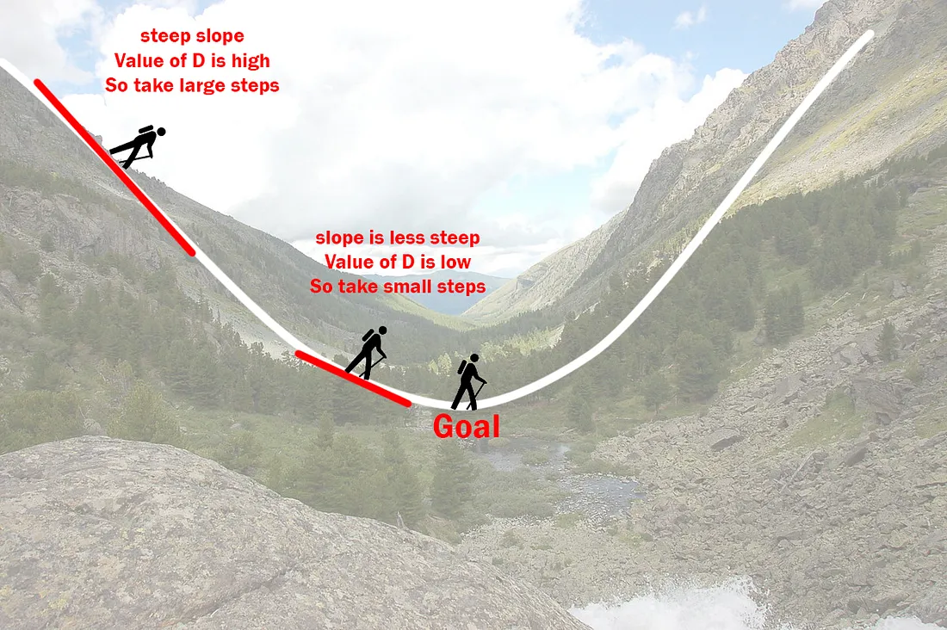
Gradient Descent
In mathematics, gradient descent is a first-order iterative optimization algorithm for finding a local minimum of a differentiable function (Wikipedia)
Task: find m and c that minimizes
x | y
0 | 2.1
1 | 4.8
2 | 8
3 | 10.5
4 | 14.3

Slide 14
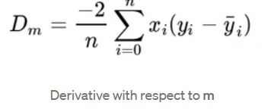
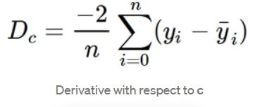
Gradient Descent step by step process
1. Initially let m = 0 and c = 0. Let L be our learning rate. This controls how much the value of m changes with each step. L could be a small value like 0.0001 for good accuracy.
2. Calculate the partial derivative of the loss function with respect to m, and plug in the current values of x, y, m and c in it to obtain the derivative value D.
x | y
0 | 2.1
1 | 4.8
2 | 8
3 | 10.5
4 | 14.3

Slide 15
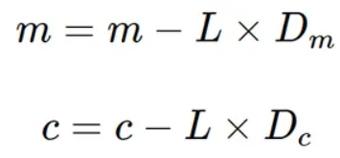
3. Now we update the current value of m and c using the following equation:
4. We repeat this process until our loss function is a very small value or ideally 0 (which means 0 error or 100% accuracy). The value of m and c that we are left with now will be the optimum values.

Slide 16
Result
x | y
0 | 2.1
1 | 4.8
2 | 8
3 | 10.5
4 | 14.3

Slide 17
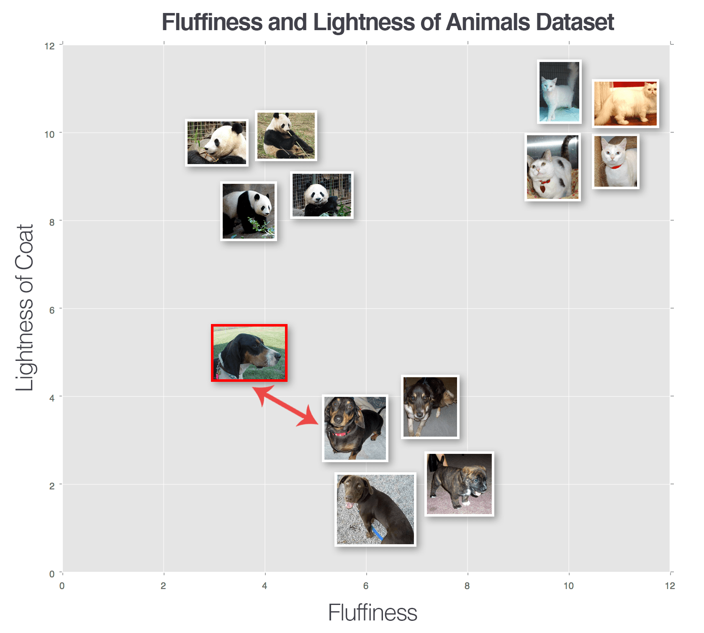
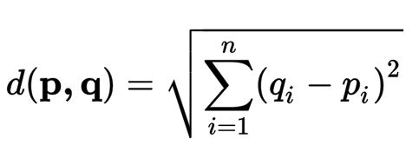
Supervised Learning model for classification
K-nearest Neighbors (K-NN): The k-nearest neighbors (KNN) algorithm is a data classification method for estimating the likelihood that a data point belongs to one group or another based on which group the data points nearest to it belong to.
Euclidean Distance

Slide 18
Supervised Learning real-world example
Cat v.s. Dog classifier

Slide 20
Review- Types of Machine Learning
Supervised Learning
Given: Training data + desired output (labels)
Classification & Regression
Unsupervised Learning
Given: Training data (without labels)
Reinforcement Learning
Rewards from sequence of actions
Based on slide by Pedro Domingos

Slide 21
Unsupervised Learning for clustering
Unsupervised Learning: Unsupervised Learning uses algorithms to analyze and cluster unlabeled datasets. These algorithms discover hidden patterns or data groupings without the need for human intervention.

Slide 22

Unsupervised Learning model for clustering
K-means clustering: K-means clustering is a distance-based method that partitions n observations into k clusters.

Slide 23
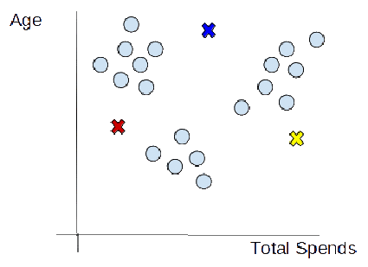
Algorithms for K-means clustering
1. Choosing the number of clusters
The first step is to define the K number of clusters in which we will group the data. Let’s select K=3
2. Initializing centroids
Centroid is the center of a cluster. But initially, the exact center of data points will be unknown, so we select random points and define them as centroids for each cluster. Since k=3, We will initialize 3 centroids in the dataset.
Resource from Neptune.ai

Slide 24
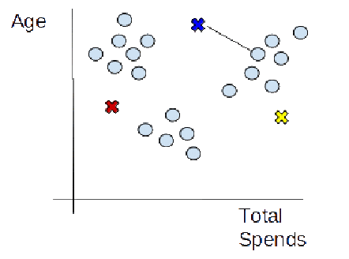
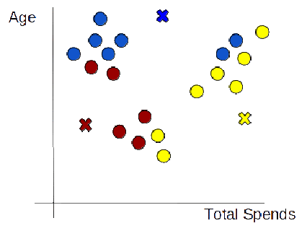
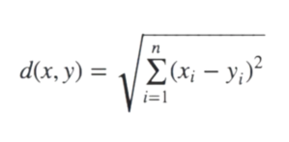
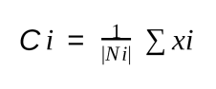
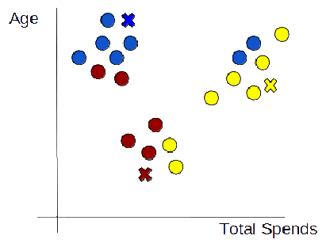
3. Assign data points to the nearest cluster
Now that centroids are initialized, the next step is to assign data points X_{n} to their closest cluster centroid C_{k}
4. Re-initialize centroids
Next, we will re-initialize the centroids by calculating the average of all data points of that cluster.
Resource from Neptune.ai

Slide 25
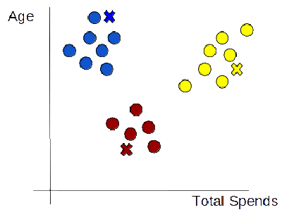
5. Repeat step 3 and step 4 until the centroids of newly formed clusters stop changing or the maximum iteration is reached.
Resource from Neptune.ai

Slide 26
Steps to machine learning
1. Collecting data
2. Preparing the data (Processing & Segmentation)
Feature Selection
Feature Extraction
3. Training the model
4. Evaluating the model
5. Parameter tuning
6. Make predictions

Slide 27
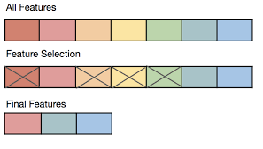
Feature selection and extraction
Feature extraction starts from an initial set of measured data and builds derived values (features) intended to be informative and non-redundant (Wikipedia)
Feature selection can be a manual process or uses dimensionality reduction techniques such as principal component analysis (PCA).

Slide 28


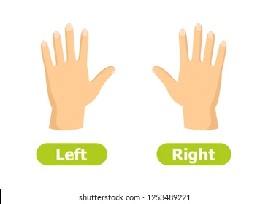
Machine learning applications in BCI
Emotion Classification
Stress Classification
Motor Imagery Classification
Notes:
https://www.facebook.com/HAppysad282/photos/
https://www.dreamstime.com/woman-stress-panic-vs-yogi-girl-calm-relax-vector-illustration-lady-surrounded-stress-factors-shedule-brain-storm-image164054650
https://www.shutterstock.com/search/left-right-hands

Slide 29
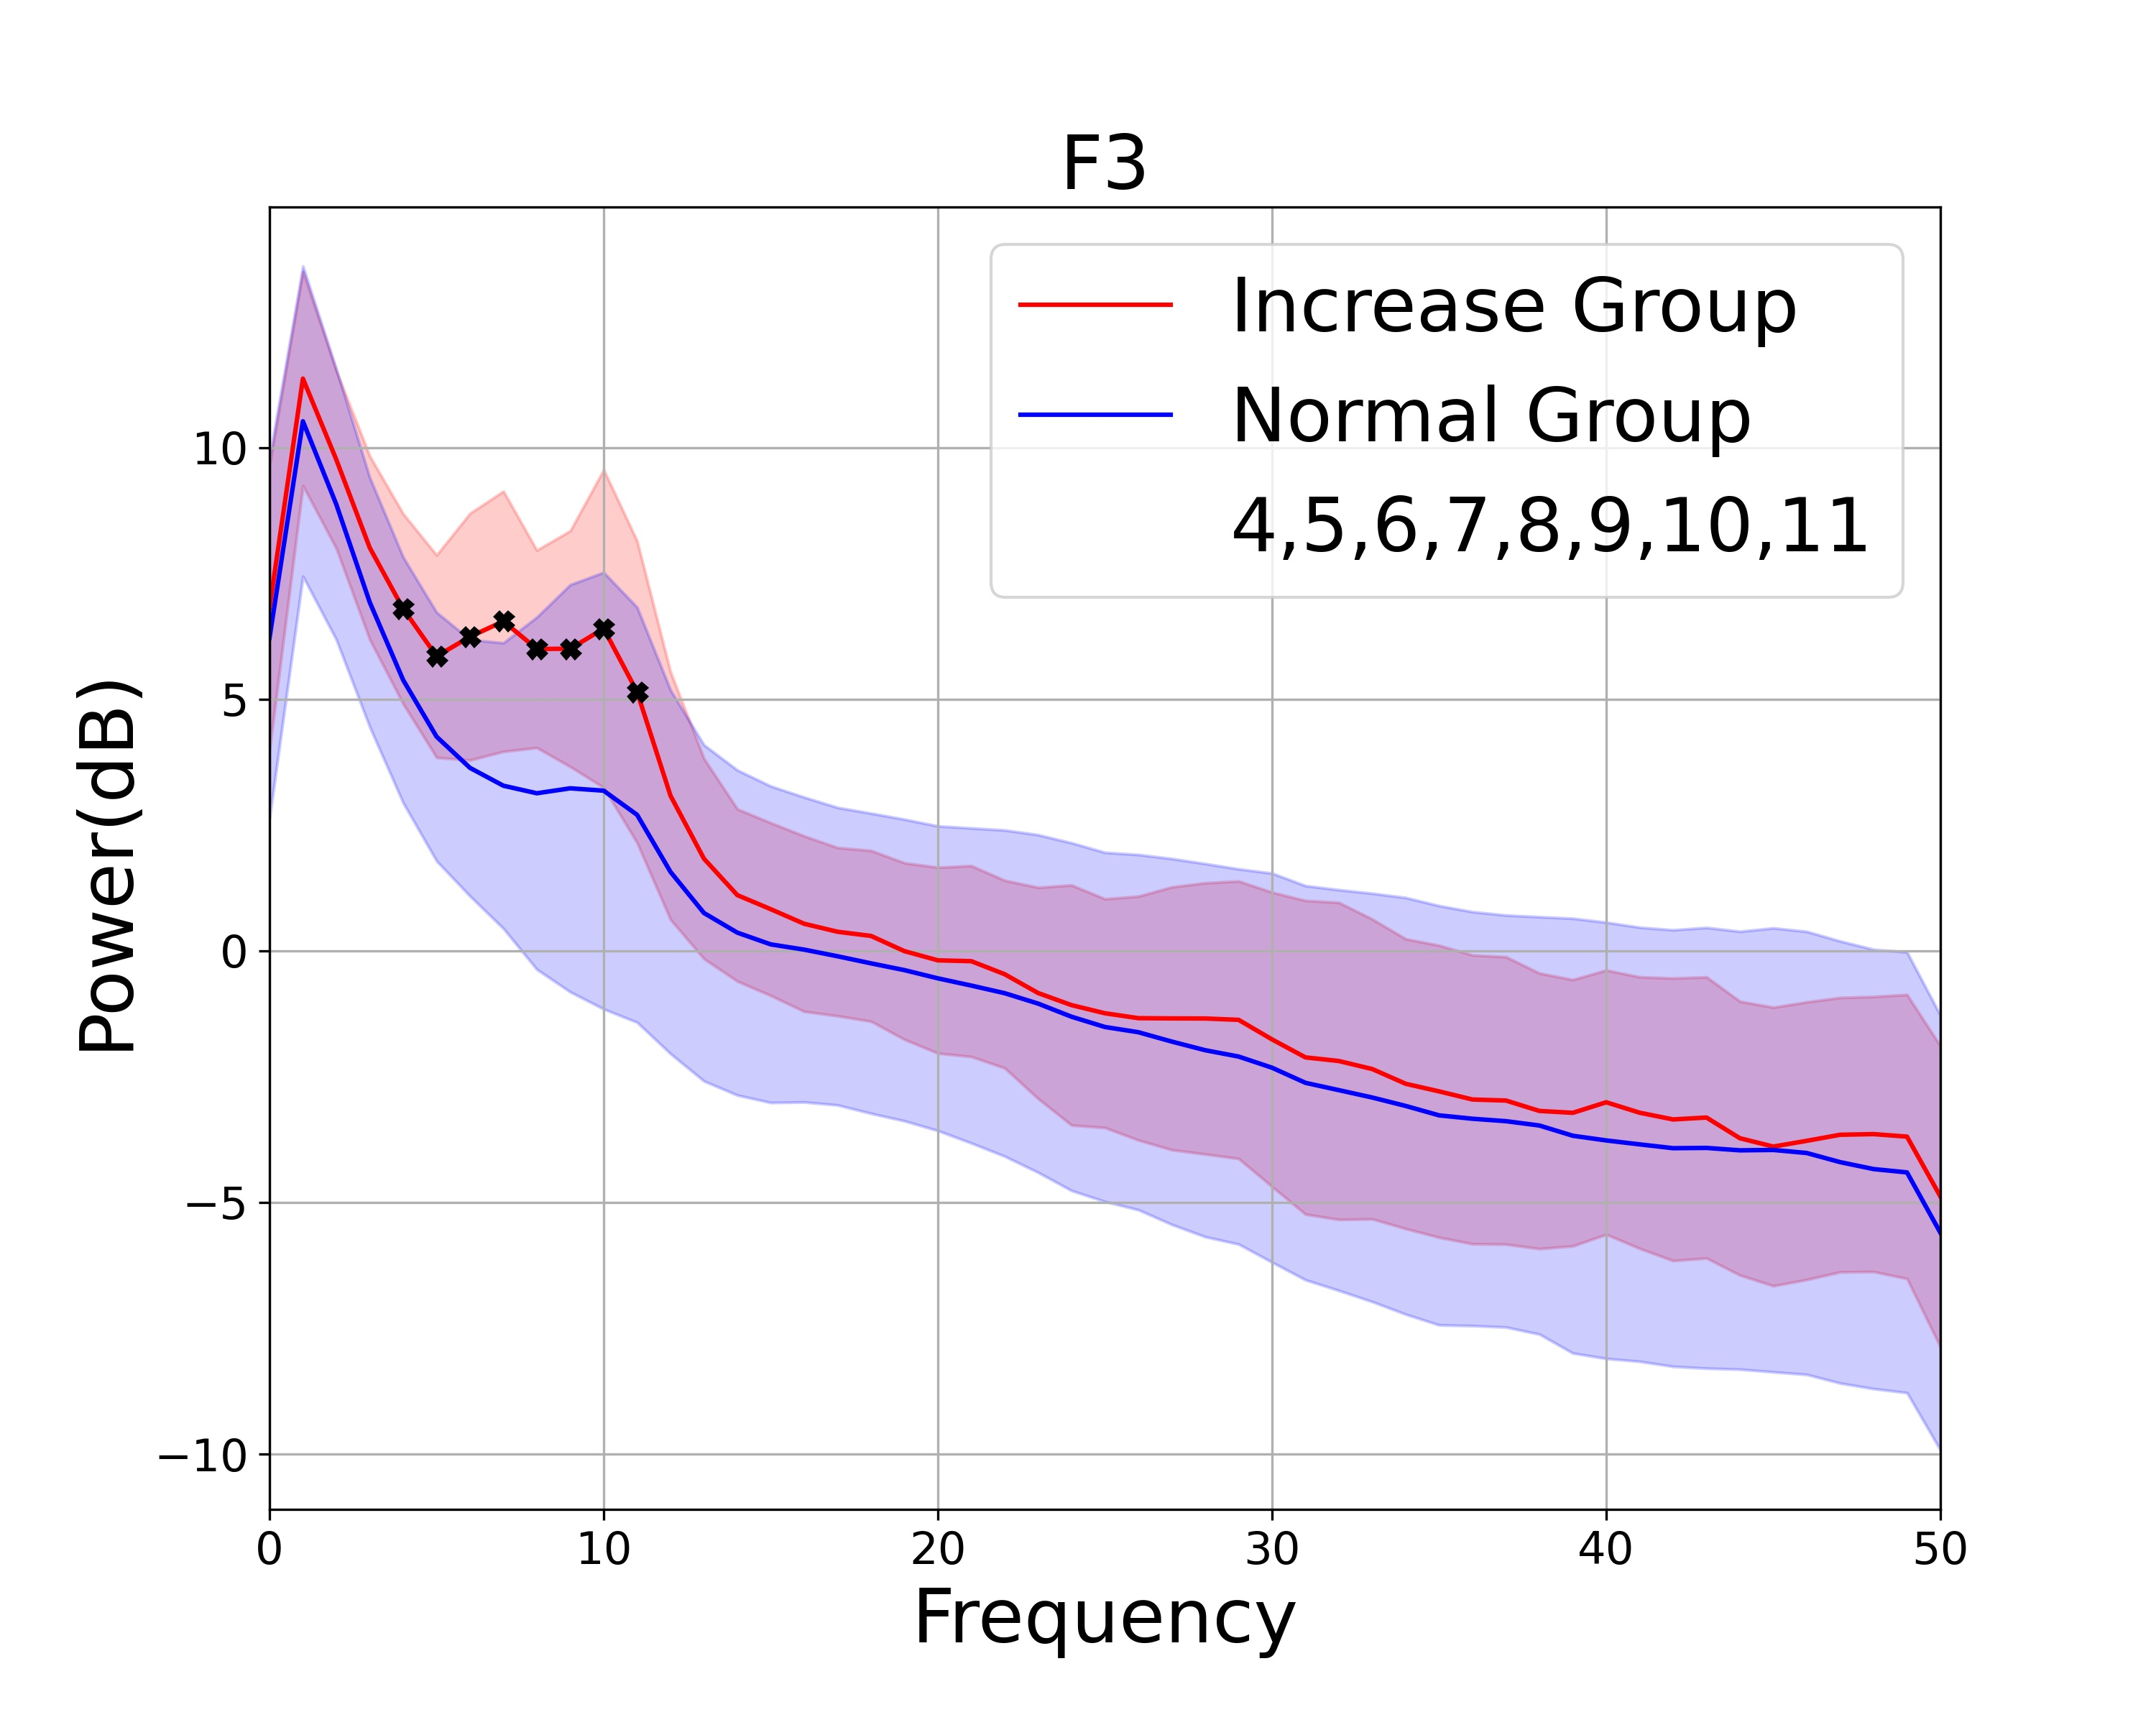
The most commonly used feature for EEG data classification
1. Frequency & Power information

